Slide 1
DR.SNSRCAS, CBE
SUBJECT: CLOUD TECHNOLOGY FUNDAMENTALS
COURSE CODE:21UCA501 UNIT - V
TITLE: Cloud Management Products
YEAR: III SEMESTER 2022-2023 (ODD)

Slide 2
Cloud Management Products
Cloud management software and services is a very young industry, and as such, it has a very large number of companies, some with new products and others with older products competing in this area.

Slide 3
Cloud Management Products
some of the current players in this market, along with the products they either are offering or are promising in the very near future.
When considering products in cloud
management, you should be aware
that—as in all new areas of technology—there is considerable churn as companies grow, get acquired

Slide 4
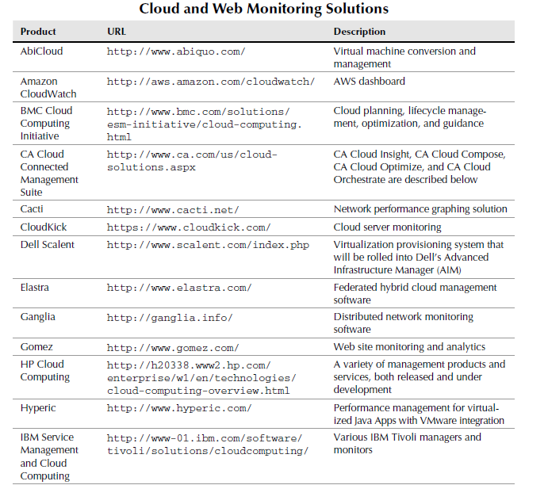
Cloud Management Products

Slide 5
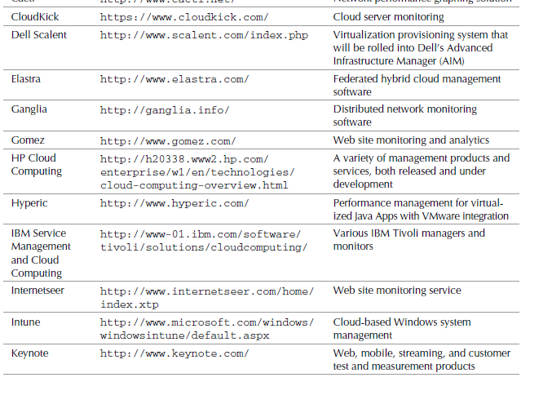
Cloud Management Products

Slide 6
Thank You

